Slide 1

Fuddle
Baris Tevfik
Matt Lee
David Cheung
Ben Paolillo

Slide 2
Introduction
Our goal at Fuddle is to create one website where visitors are greeted with an abundance of popular images from across the globe submitted by fellow users who share their interests.
Notes:
Image Hosting
Each user has an account

Slide 3

Features
Users can upload images.
Upvote/downvote on each image.
Users have their own account where they have access to all the images they’ve uploaded.
Users can comment on fellow users’ images.
Users can create albums.
h

Slide 4


Features (continued)
Tile One
If you love an image, cuddle it (a form of favoriting an image).
Image searching.
Username searching.
Filtering for highly downvoted images.
The ratio of an image having 10 downvotes per 1 upvote marks it as spam.
Ti

Slide 5
Layout
Main page
Most interesting pictures by upvote count
Dynamic tiles that reorder when the window is resized
Results in a more interesting and unique experience
Account page
Pictures uploaded by user in blog format
User Bio
Albums and cuddles
Change avatar page
Upload your own avatar or use Gravatar
Sign-up page
Register with Fuddle
Email, username and password
Security Question

Slide 6
Layout (continued)
Individual image page
Upvote, downvote and cuddle count
Like and share on Facebook
Email to a friend or colleague
Comment section
Error page (404)
Text saying “This page is shy” appears on page
Administrator page
Superuser privileges
Ban users

Slide 7
Layout (continued)
Upload page
Upload images from your computer.
Set title and description of the image.
Have the option to upload it to a specific album or to the user’s general uploads area.
Image preview to allow the user to preview the image before uploading.
Album page
Shows the images within the album.
Album thumbnail is selectable by user; if the user does not select one, a default image is used.
Must upload images separately to albums.
Deleting an image from an album deletes the image too.
Deleting an album deletes all the images in that album.

Slide 8
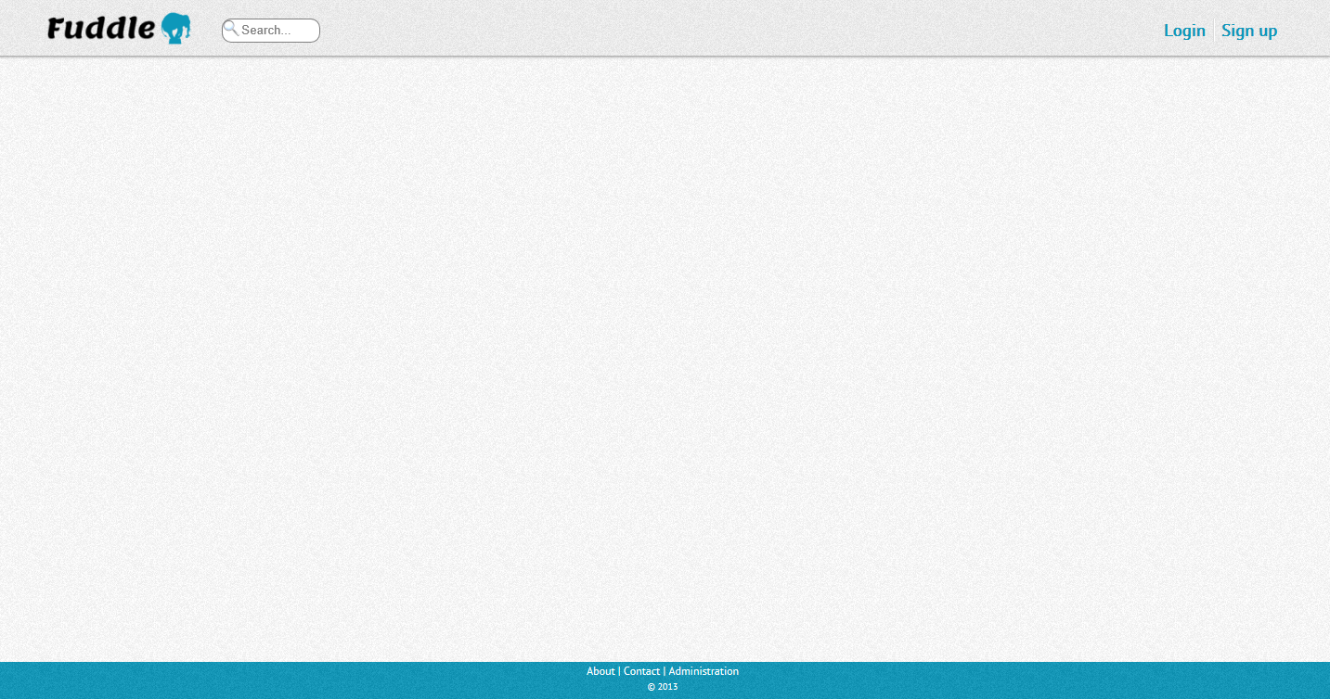
Master Page
The master page consists of a header, container and a footer.
Every page on the website uses this master page and renders its content in the container.
The search box is conveniently placed on the header so that it can be reached from any other page.
The login/signup links change to logout/profile links when a user logs in.

Slide 9
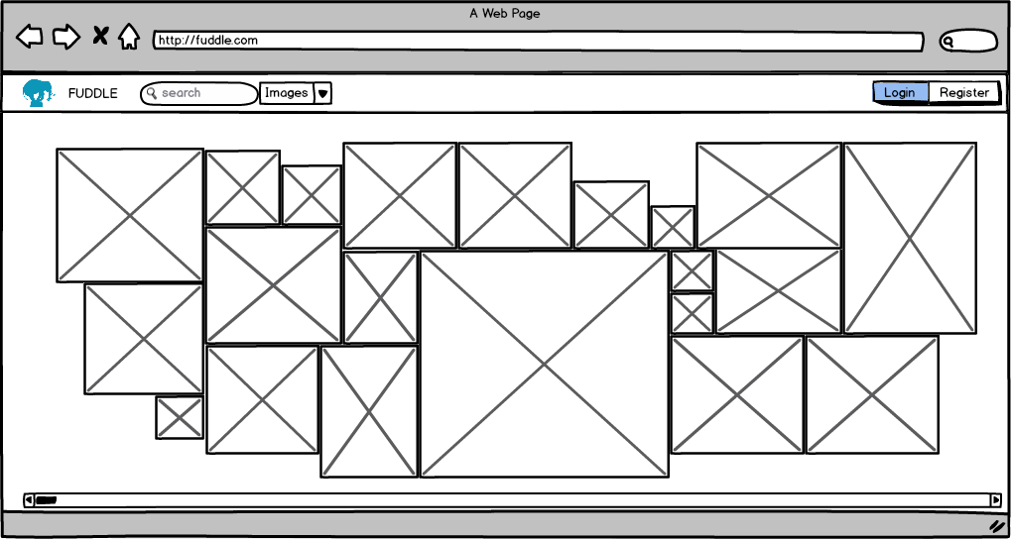
Mockup – Main Page

Slide 10
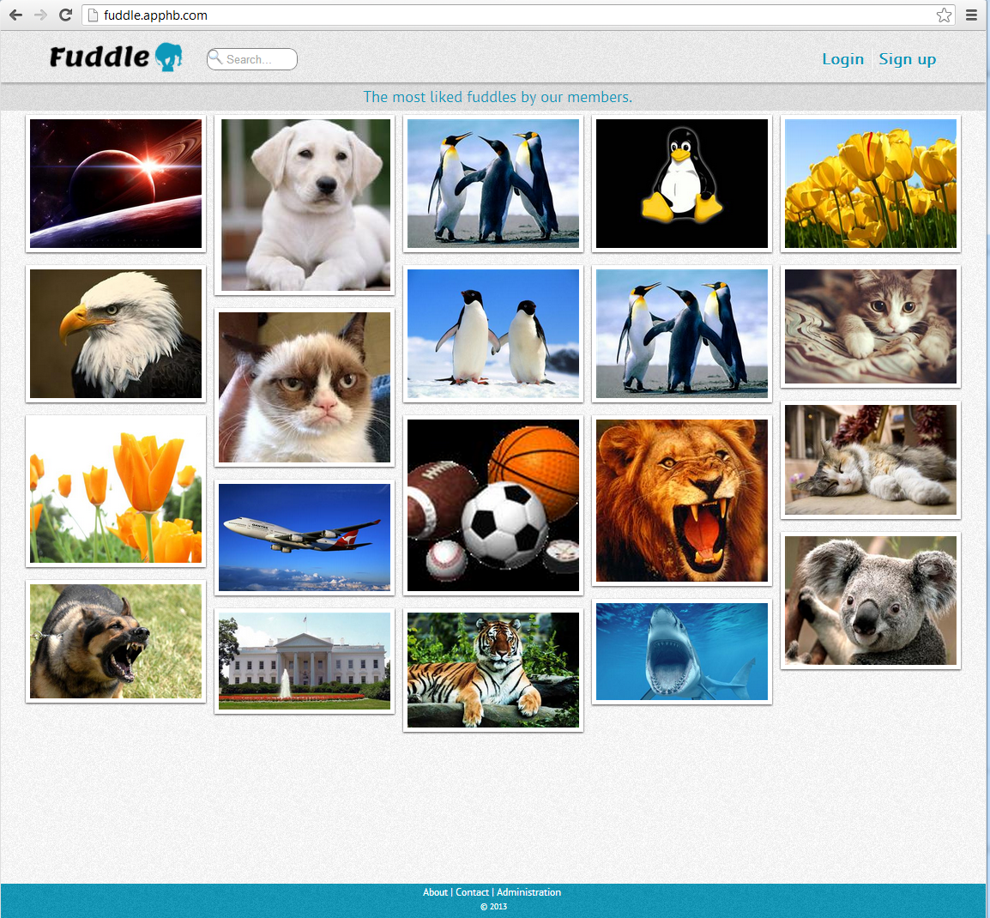
Final – Main Page
Most liked 20 images are displayed on main page, with descending order.
Layout for tiling dynamic images are created by Jquery.
Open source “Freetile” project is used for this functionality.
(source:github.com/yconts/Freetile)
Each image displays the upvote count when hovered.

Slide 11
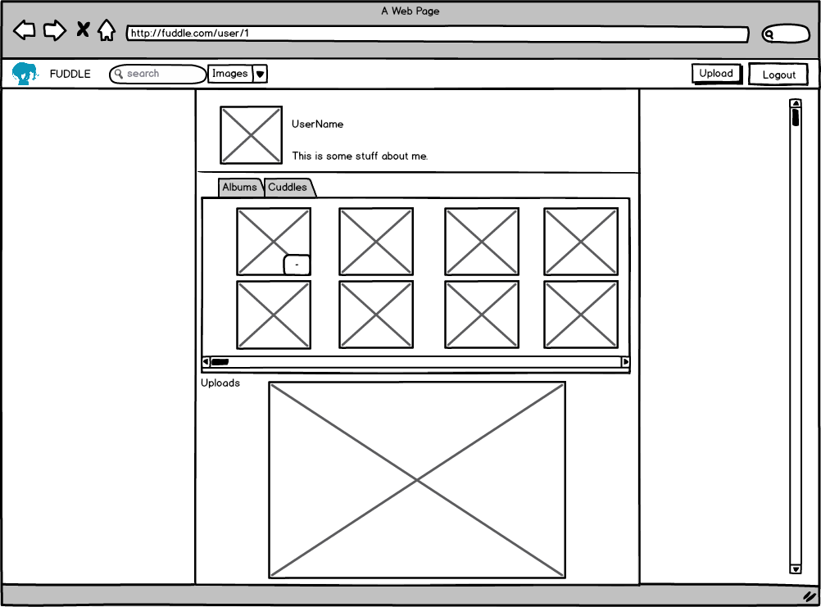
Mockup – Account Page

Slide 12
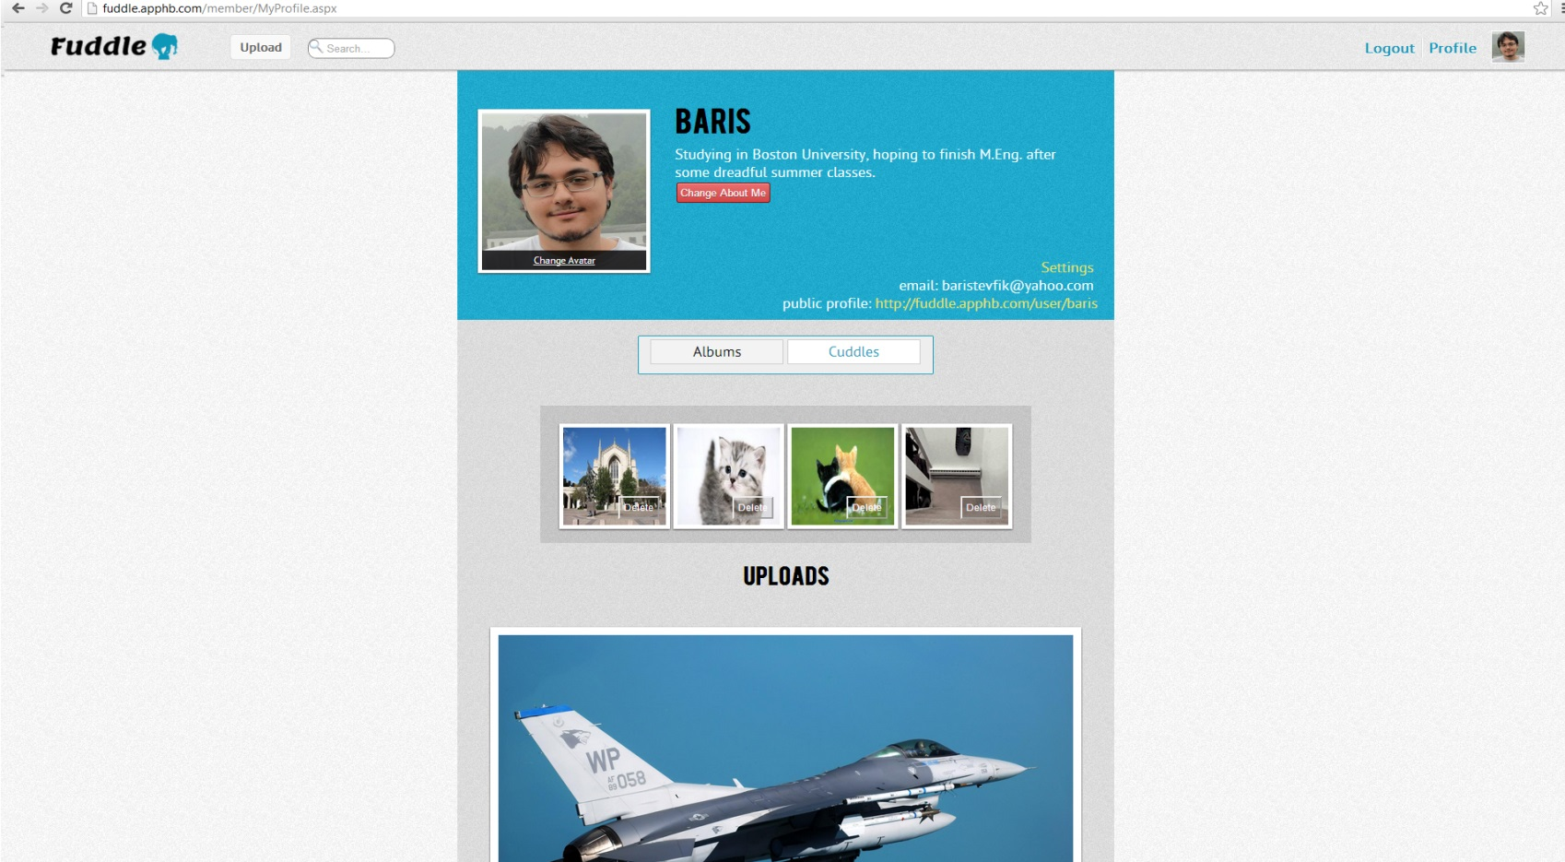
Final – Account Page
This page is in the private folder ‘member’. Only members have access to it.
In this page, users can update their about me/bio, remove cuddles, and create new albums.
They also can find links to change their avatar and update account settings (such as changing email).
A read-only version of this page is viewed on public profile pages with path as /user/<username>.

Slide 13
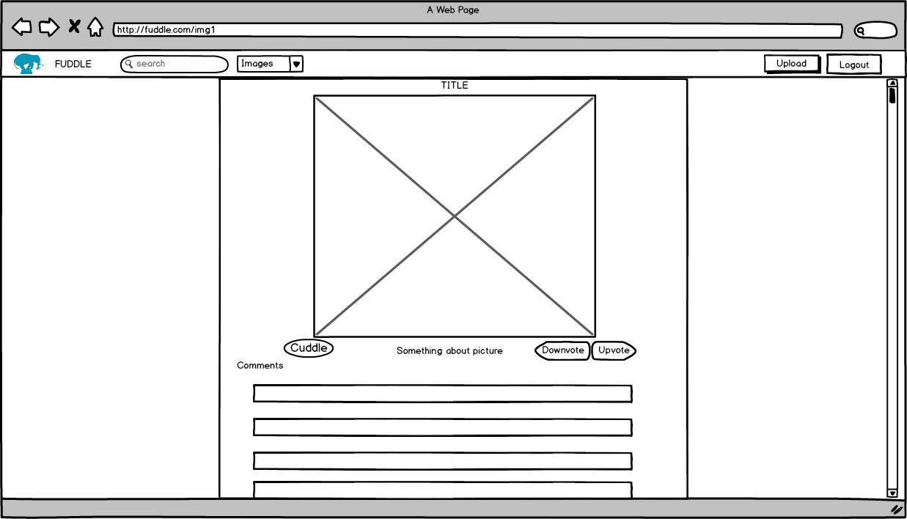
Mockup – Individual Image Page

Slide 14
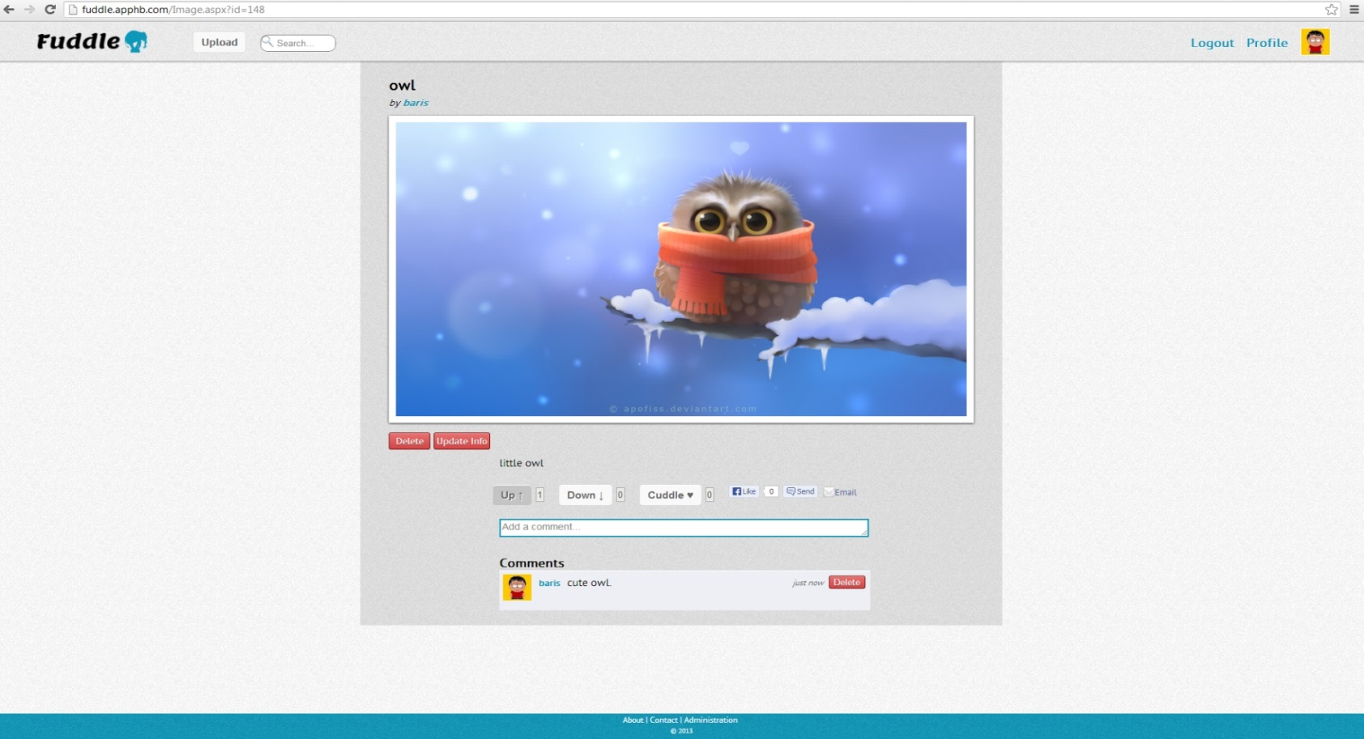
Final – Individual Image Page
This page displays an image along with its information (title and description)
User who uploaded the picture has the options to update the information or delete the image.
Users can comment on the image and have the option to delete their comment.
Users can vote once (up or down) and cuddle an image and take their votes back.
Sections in this page are part of different update panels, so when there is an update, only the appropriate section reloads. This increases the user experience.

Slide 15
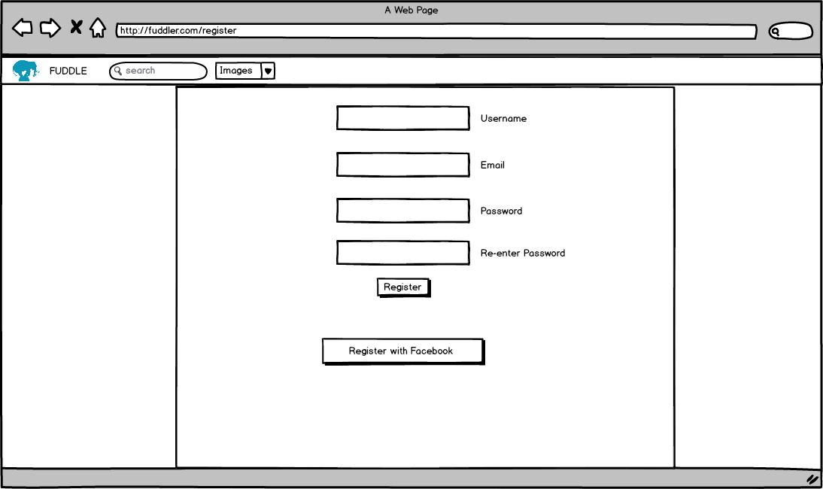
Mockup – Sign-up Page

Slide 16
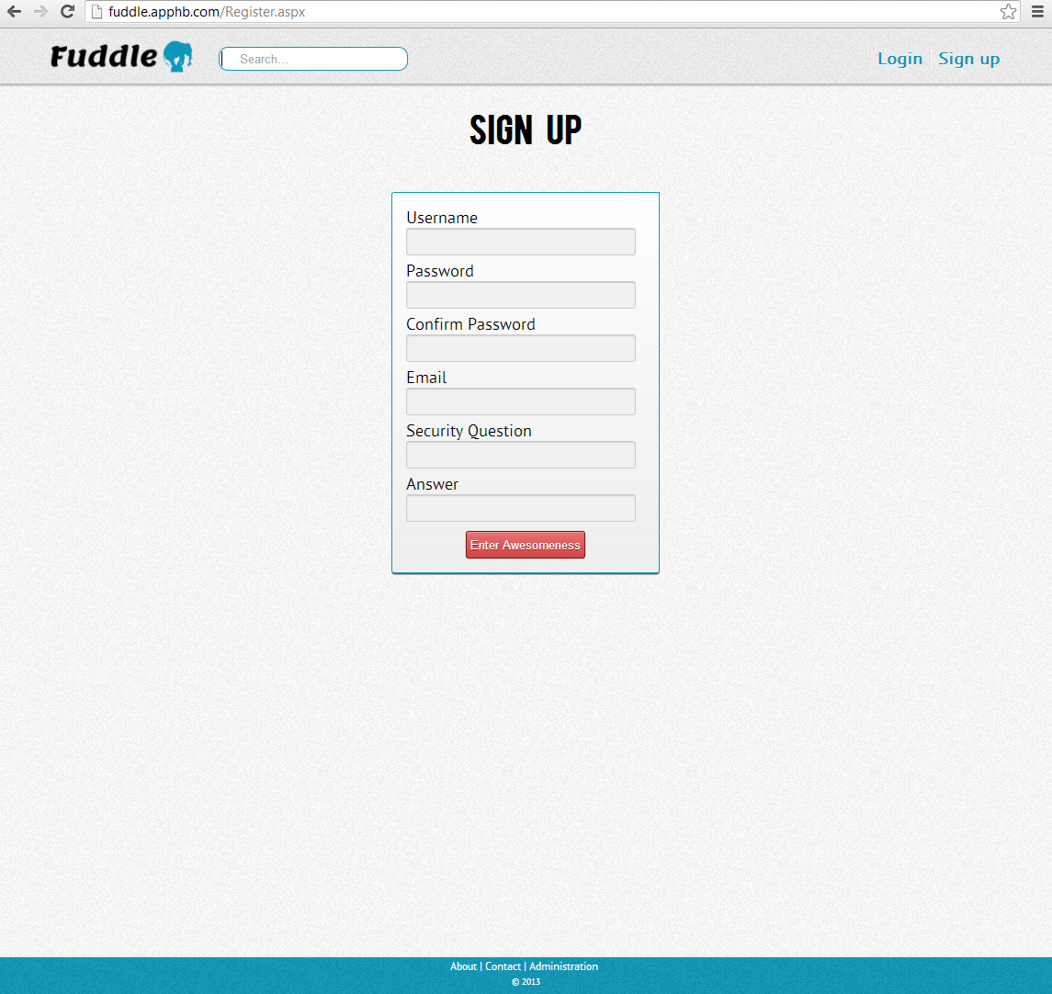
Final – Sign-up Page
CreateUserWizard provided by asp.net is used on this page.
When a user successfully registers, a verification link is sent to their email.
Users can’t login until they click the link that is sent to their email.
We have set up a Gmail account to accomplish this feature.

Slide 17
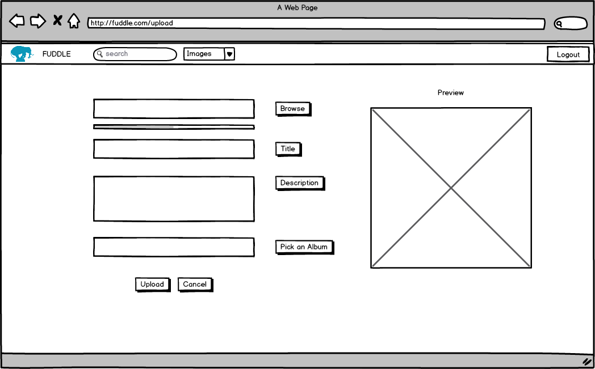
Mockup – Upload Page

Slide 18
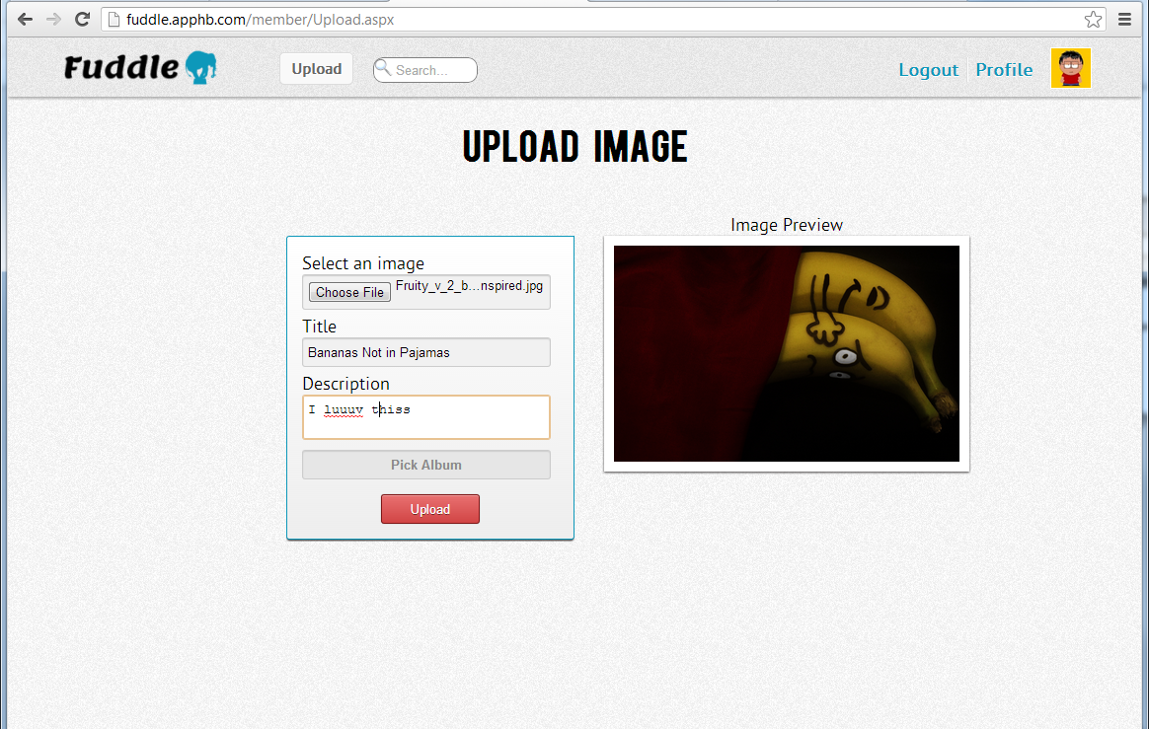
Final – Upload Page
Uploading images is one of the main features of the website. Only registered users can upload pictures.
A preview of the image is shown on web browsers that support the FileAPI.
Users also have the option to pick an album to upload the picture to.

Slide 19
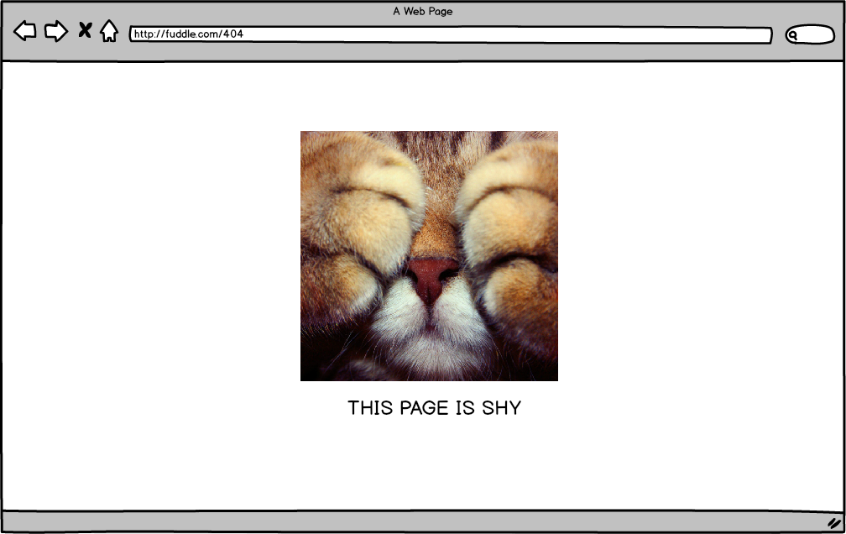
Mockup – Error Page (404)

Slide 20
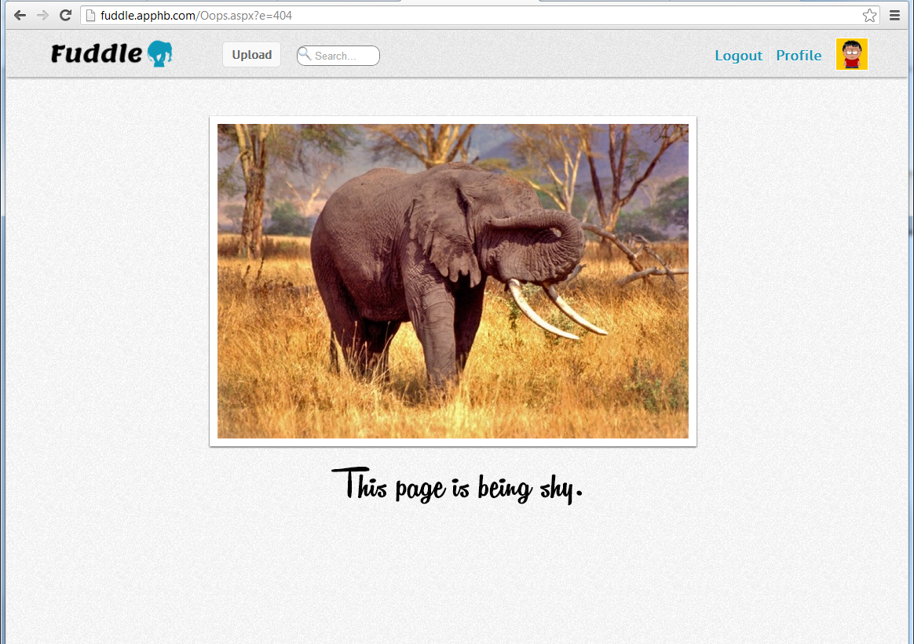
Final – Error Page (404)
Custom error pages are shown on appropriate errors. Such as 404, 403 and 500.
Error pages are configured in Web.config file in the root folder.

Slide 21
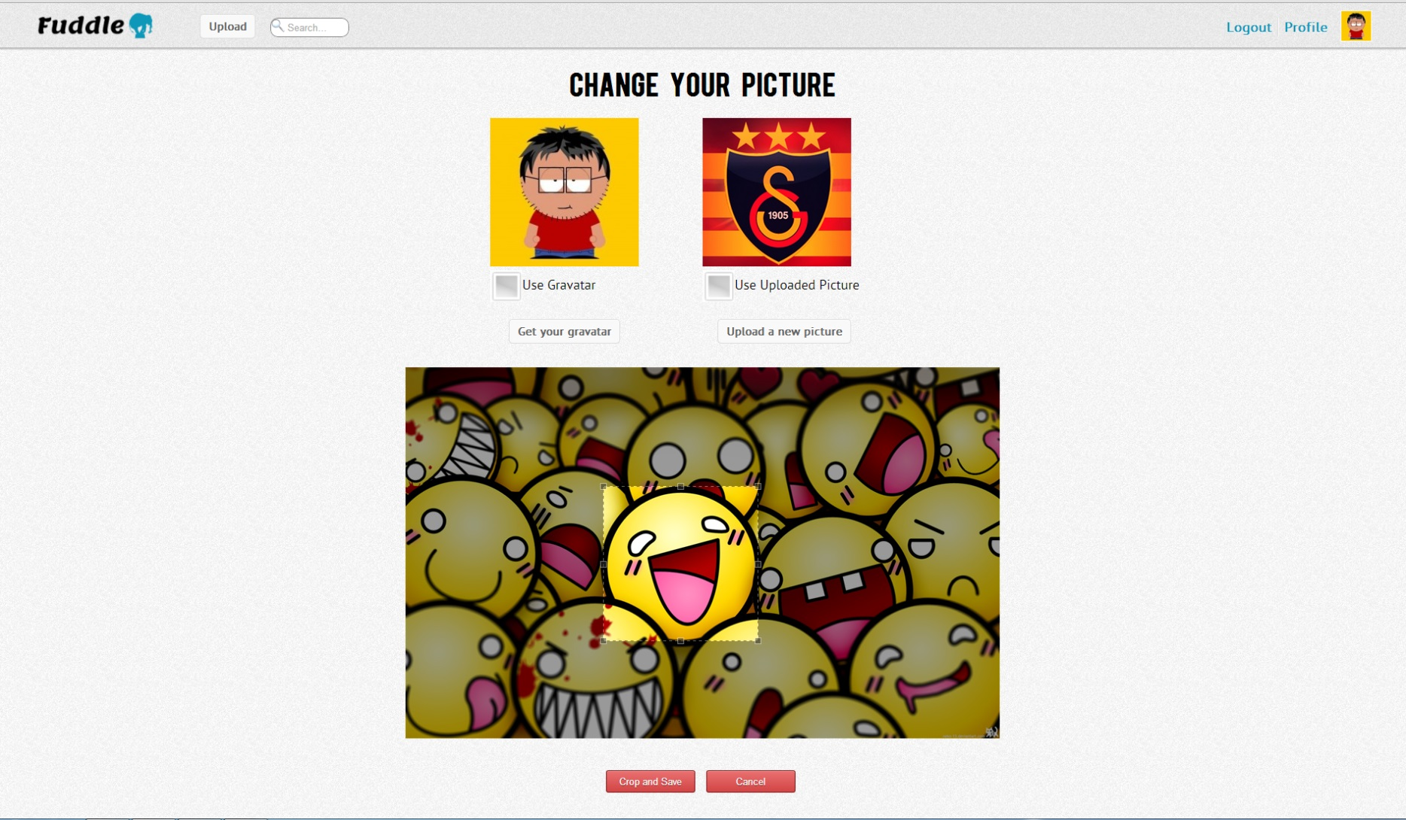
Change Avatar Page
Users have option to upload an image for their profile avatar, or use Gravatar.
Gravatar can be set up at gravatar.com
Jquery is used to crop the image to a square ratio. (source: deepliquid.com/content/jCrop.html)

Slide 22
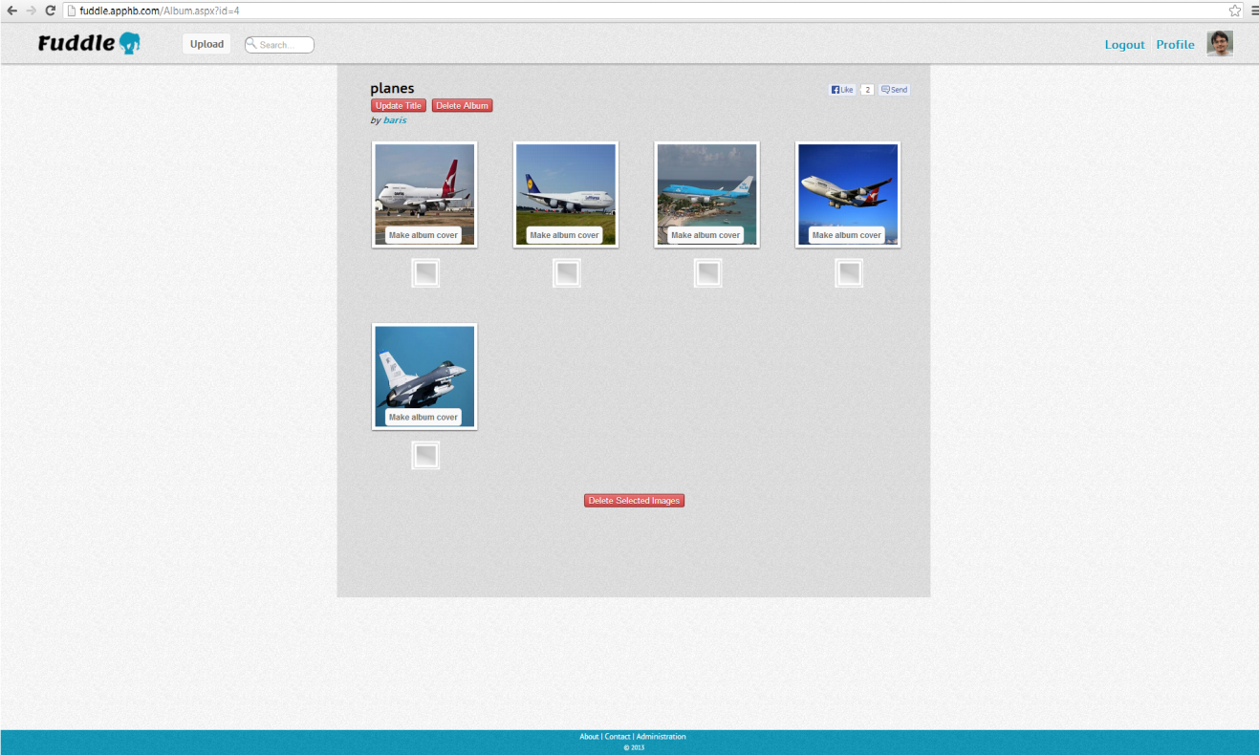
Album Page
Users can create albums through their profile page, and they can upload images to a particular album.
Users have the option to update the title of an album or delete an album.
Deleting an album deletes all of the pictures in that album.
Users can also choose to delete some of the pictures from the album by using checkboxes.
One of the images from the album can be chosen as the album cover which will show in the user profile page.

Slide 23
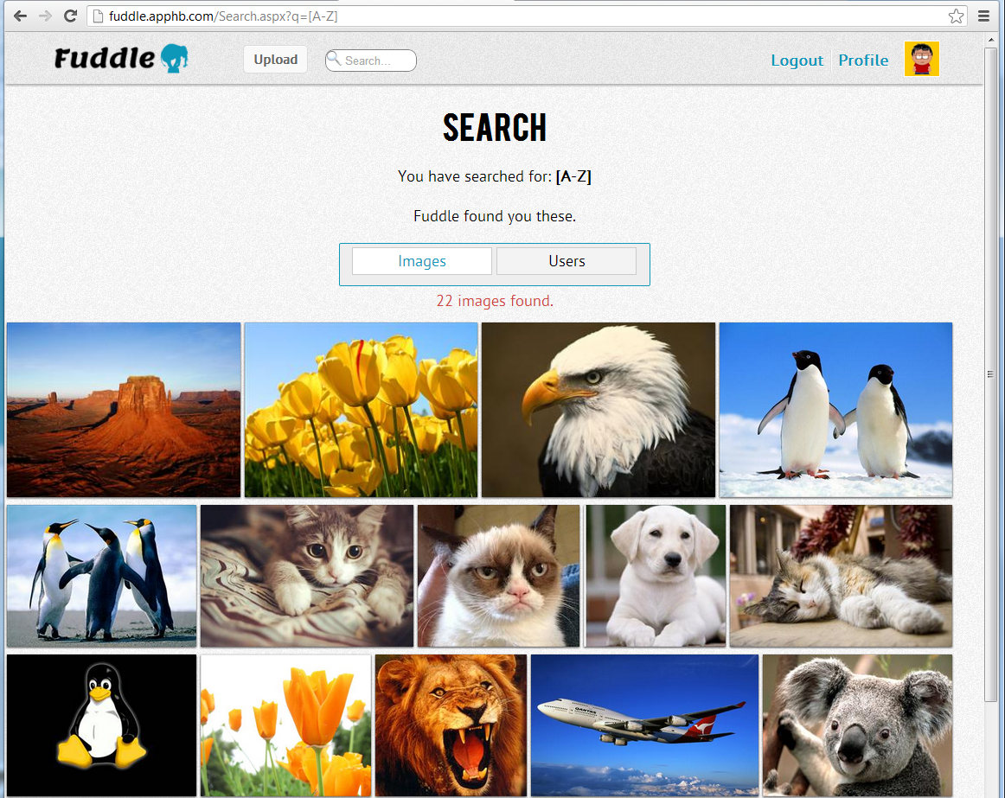
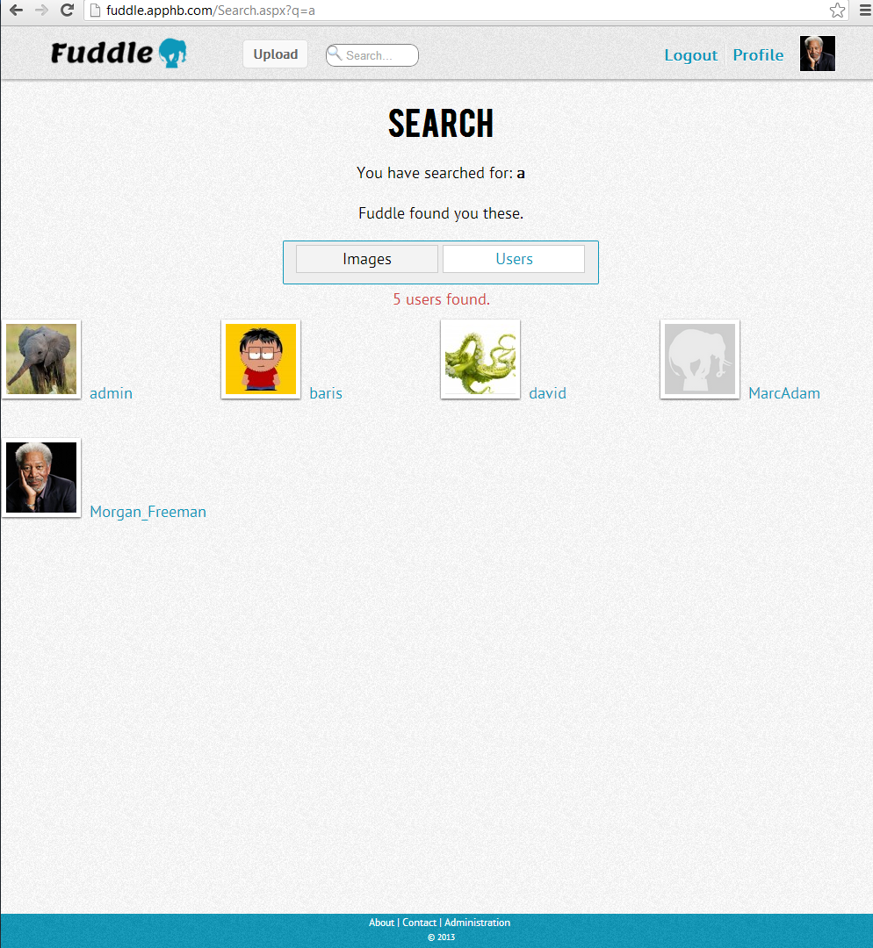
Search Page
Searching images
Searching users
On search page users can refine their search by ‘images’ or ‘users’.
A webservice is used to search the database, the returned format of the service is JSON.
From the client side, webservice is called with AJAX and returned JSON information is parsed, then images are preloaded on to page.
Only 20 images are loaded at a time to increase the performance. Users can load more images by clicking on ‘load more’ button.

Slide 24
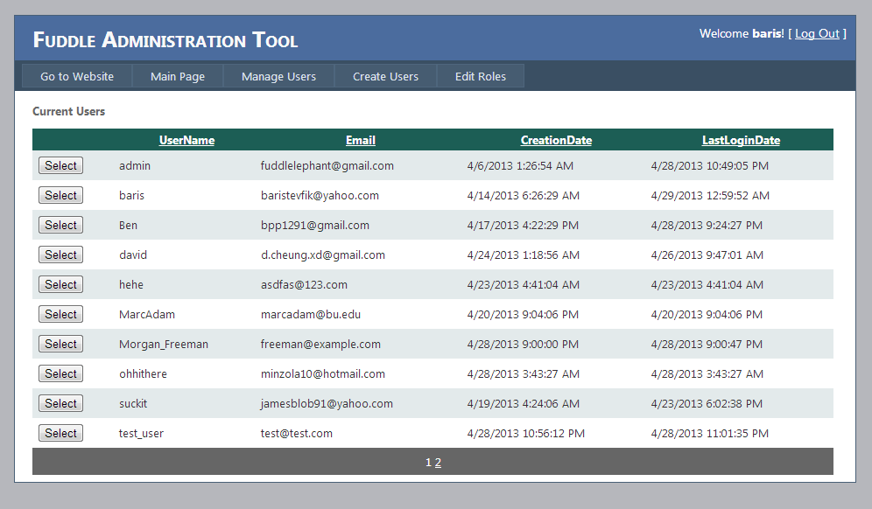
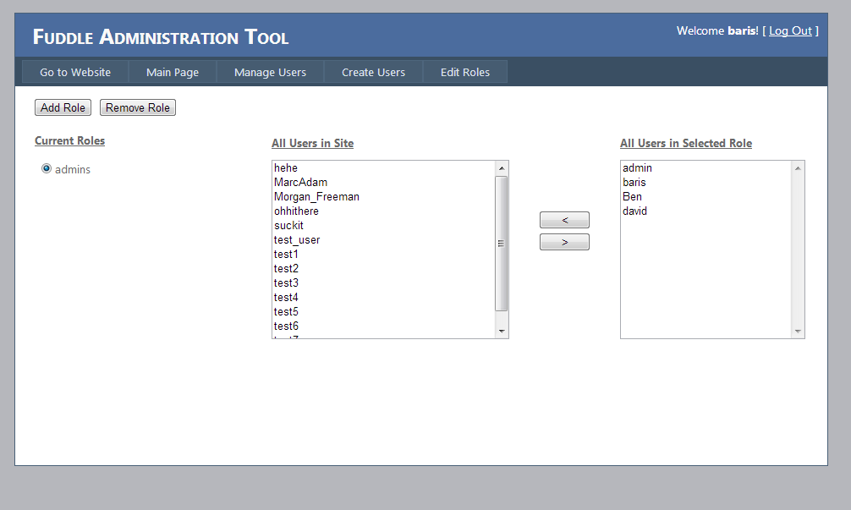
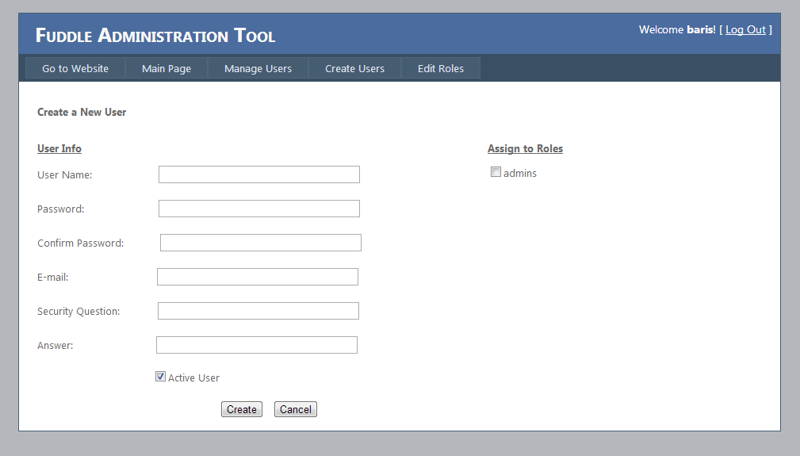
Admin Pages
Admin pages give the ability to manage users online, similar to the configuration tool provided by Visual Studio.
Admins can change roles of users, create new users and update user information.
Admins have also the option to inactivate users, which will prevent them from logging into the website.

Slide 25
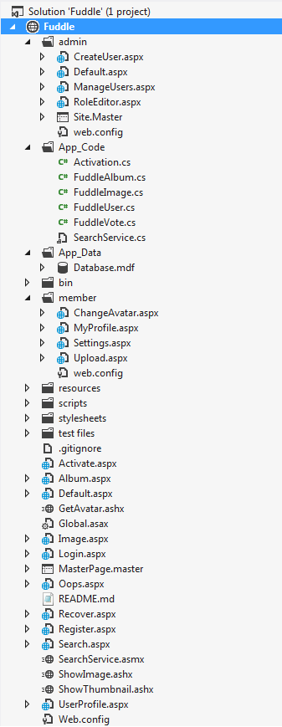
Website Organization
Public files are stored in root folder.
There are two private folders: `member` and `admin`
Every member can access to member folder which contains pages to update profile information and upload new pictures. (admins are also members)
Admins have privileges to delete/edit/update/ban users.
App_Code folder contains classes to manipulate Album, Image, User, and Vote information.
App_Code also has a class called SearchService which is used to perform search queries on the database. This service is used by Search.aspx in the root folder.
ShowImage generic handler in root folder is used to retrieve the binary data for an image and write to the page.

Slide 26
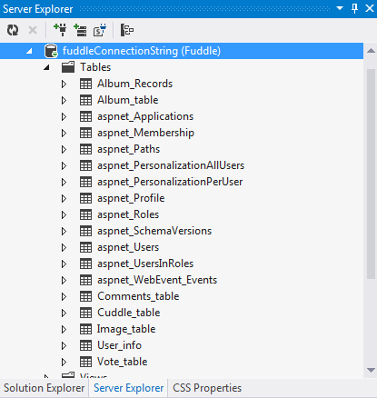
Database Design – All Tables
This is all the tables used in the database.
Tables starting with “aspnet_” are membership tables created by asp.net

Slide 27
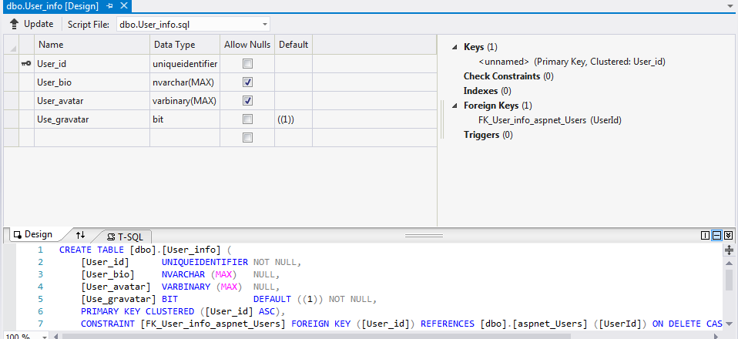
Database Design (User-Info)
We have used the default asp.net membership provider in our website.
However, this was not sufficient to store additional information.
This table stores additional information about the user.

Slide 28
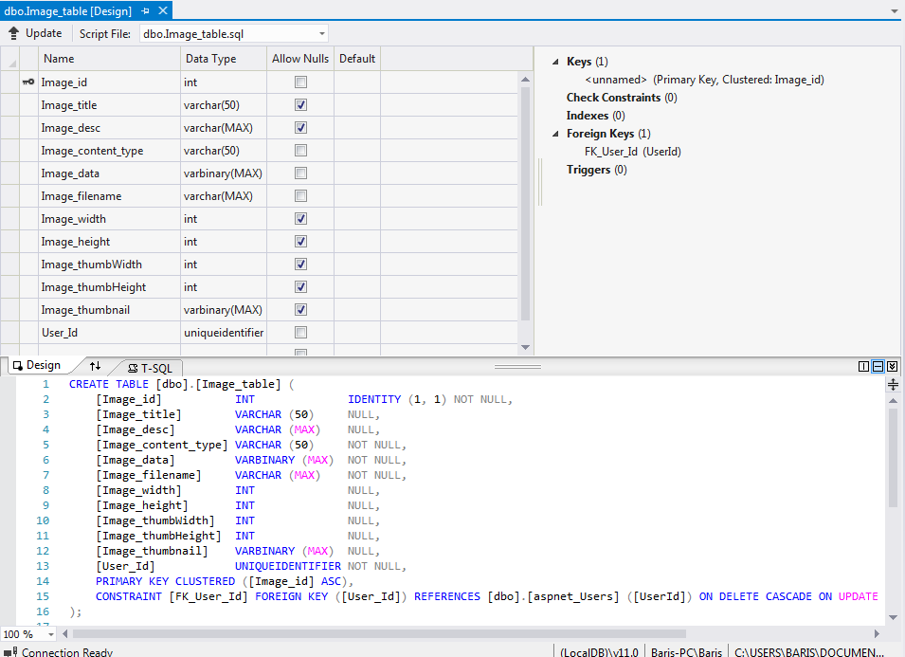
Database Design (Image Table)
Stores all the images uploaded by users
“Image_data” and “Image_thumbnail” stores images as binary data
“User_Id” is a foreign key with an ON DELETE CASCADE statement to delete all the images uploaded by that user once that user is deleted

Slide 29
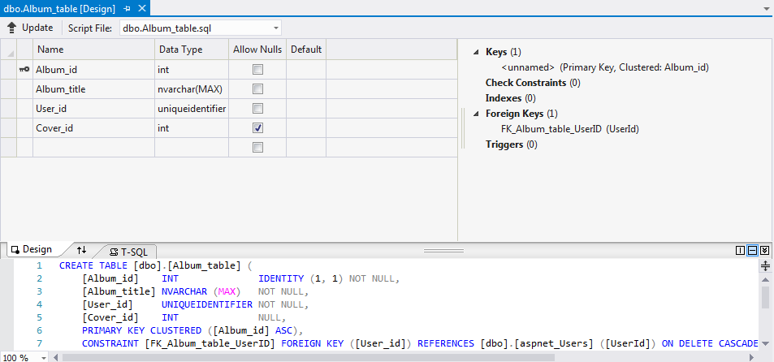
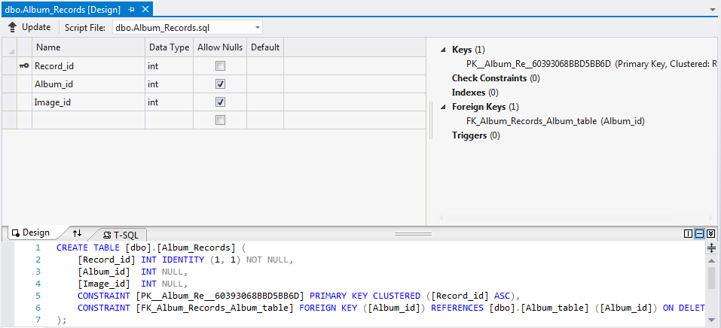
Database Design (Album Tables)
Album_table stores information about the album
“User_id” is a foreign key with an ON DELETE CASCADE statement to delete all the albums uploaded by that user once that user is deleted
Album_Records stores the image IDs of the images that belong to an album
“Album_id” is a foreign key with an ON DELETE CASCADE statement to delete all the images belonging to an album once that album is deleted

Slide 30
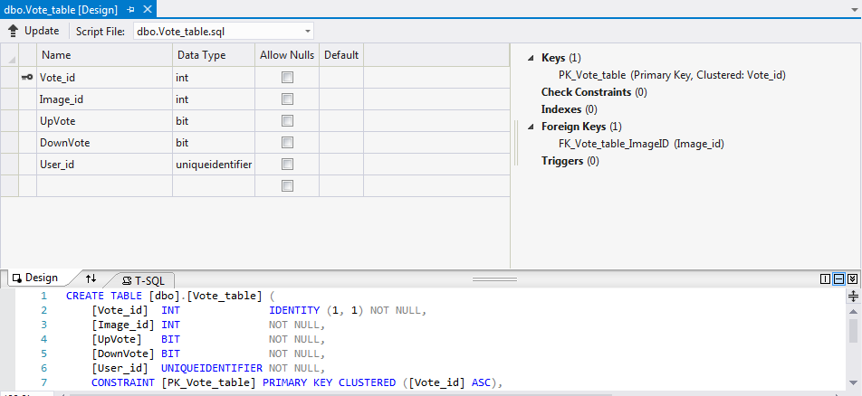
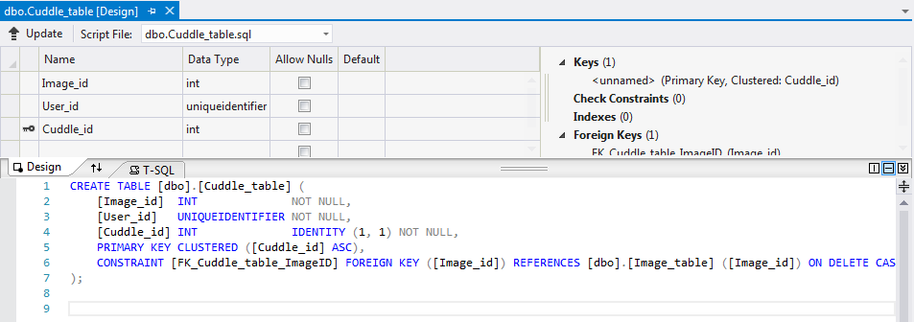
Database Design (Cuddle/Vote Table)
Stores whether a user has upvoted or downvoted an image
“Image_id” is a foreign key with an ON DELETE CASCADE statement to delete all the votes associated with a deleted image
Stores cuddles a user makes
“Image_id” is a foreign key with an ON DELETE CASCADE statement to delete all the cuddles associated with a deleted image
A separate query is used to delete all the votes and cuddles associated with a deleted user

Slide 31
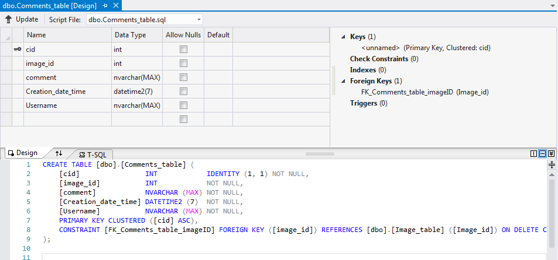
Database Design (Comment Table)
Stores all the comments of an image
The user who made the comment
The date and time that the comment was made
“image_id” is a foreign key with an ON DELETE CASCADE statement to delete all the comments associated with an image that has been deleted
A separate query deletes all the comments of a deleted user

Slide 32
Technologies Used
ASP.NET
SQL
AJAX
C#
jQuery / JavaScript
Gravatar API
Facebook like & share

Slide 33
Remarks
Website source can be found at github.com/btevfik/Fuddle
A demo of the website is hosted on fuddle.apphb.com

